Slide 1


OBJECTIVE
To introduce the HOOK model as a framework to look at creating habit forming products and services for users.
TOOL
The HOOK Model
THE FINLAB TOOLKIT

Slide 2
ABOUT ‘HOOK Model’
The Hook Model is designed to build products that create habit-forming behavior in users via a looping cycle that consists of a trigger, an action, a variable reward, and continued investment.
A habit is defined as an impulse to act on a behavior with little or no conscious thought.
Habit forming products are an effective way to increase the value of a company by driving higher customer lifetime value (CLTV) - the amount of money made from a customer before that person switches to a competitor or stops using the product/service.
Habit forming products and services also have a higher ability to price profitably and competitive edge as switching costs are perceived to be high. In addition, customers become evangelists of habit forming products and spur growth.
THE FINLAB TOOLKIT

Slide 3
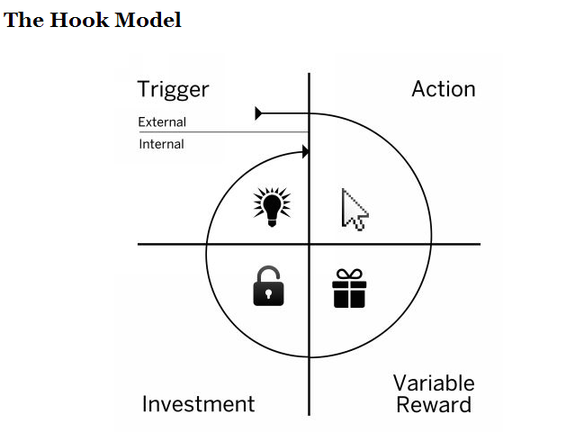
THE FINLAB TOOLKIT

Slide 4
THE HOOK MODEL | STAGE ONE
TRIGGERS
A Trigger is the starting point of any behaviour people are either consciously or unconsciously adopting. There are two types of triggers - external and internal.
THE FINLAB TOOLKIT

Slide 5
THE HOOK MODEL | STAGE ONE | TRIGGERS
EXTERNAL TRIGGERS
Habit forming products and services start changing behaviour by first cueing users with a call to action. These triggers are embedded with information which tells the user what to do next.
THE FINLAB TOOLKIT

Slide 6
THE HOOK MODEL | STAGE ONE | TRIGGERS | EXTERNAL TRIGGERS
PAID TRIGGERS
Advertising, search engine marketing, and other paid channels are commonly used to get users’ attention and prompt them to act. Paid triggers are effective but costly ways to keep users coming back. Habit-forming companies tend not to rely on paid triggers for very long, if at all.
THE FINLAB TOOLKIT

Slide 7
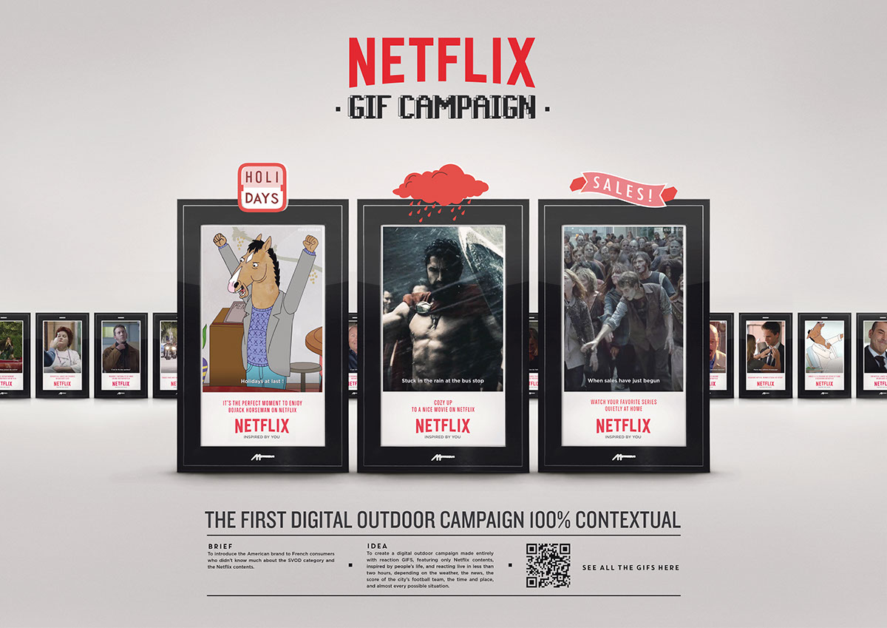
THE FINLAB TOOLKIT

Slide 8
THE HOOK MODEL | STAGE ONE | TRIGGERS | EXTERNAL TRIGGERS
EARNED TRIGGERS
Earned triggers are free in that they cannot be bought directly, but they often require investment in the form of time spend on public and media relations. Favourable press mentions, hot viral videos, and featured app store placements are all effective ways to gain attention. Earned triggers are often short lived triggers and need investment into keeping the ‘buzz’ going for longer periods of time.
THE FINLAB TOOLKIT

Slide 9

THE FINLAB TOOLKIT

Slide 10
THE HOOK MODEL | STAGE ONE | TRIGGERS | EXTERNAL TRIGGERS
RELATIONSHIP TRIGGERS
One person telling others about a product or service can be a highly effective external trigger. Whether through electronic invitations, a Facebook like and share, or just simple word of mouth - referrals from friends and family are a key reason for adoption. Relationship triggers can create viral hyper-growth for offerings. This requires an engaged and committed user base that trusts the solution, and needs the users to know the word of mouth is not planted or fabricated in which case the loss of goodwill and faith can be drastic.
THE FINLAB TOOLKIT

Slide 11
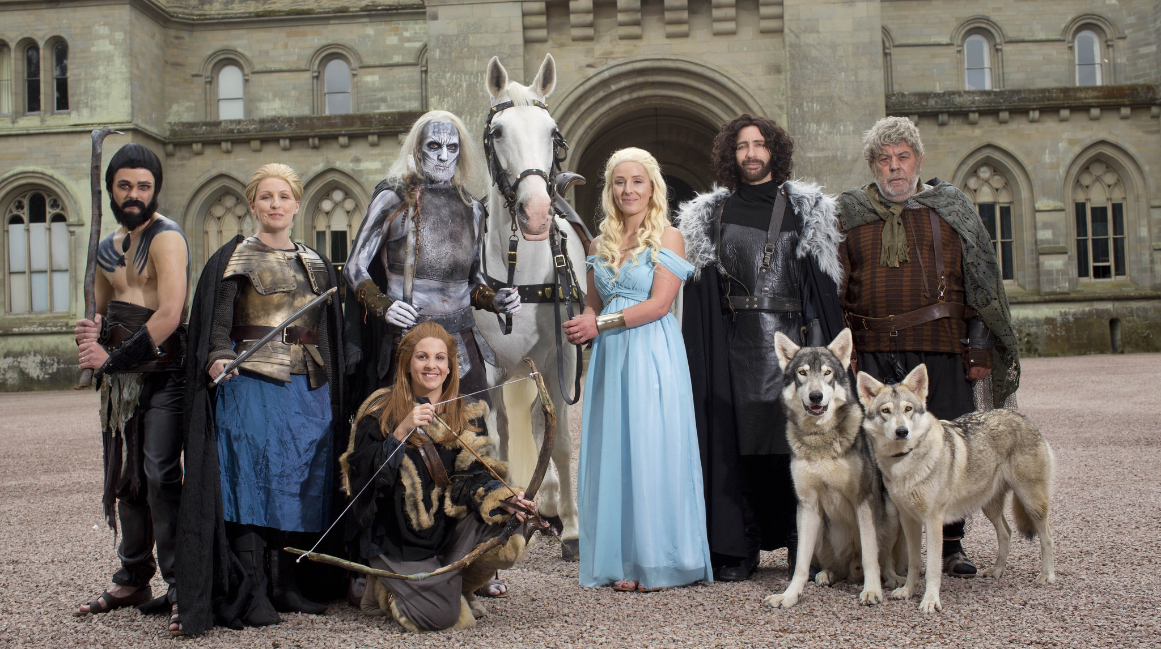
THE FINLAB TOOLKIT

Slide 12
THE HOOK MODEL | STAGE ONE | TRIGGERS | EXTERNAL TRIGGERS
OWNED TRIGGERS
Triggers that own a piece of real estate in the user’s environment. They consistently show up in the user’s use space - an app icon, a notification, a daily email update etc. These triggers are only set after users sign up for an account, submit their contact details, install an app etc. Owned triggers prompt repeat engagement until a habit is formed.
THE FINLAB TOOLKIT

Slide 13
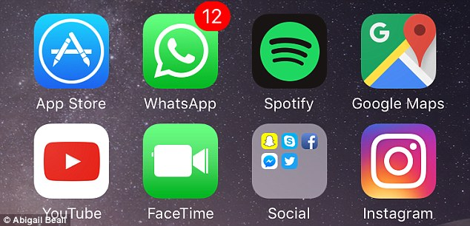
THE FINLAB TOOLKIT

Slide 14
THE HOOK MODEL | STAGE ONE | TRIGGERS
INTERNAL TRIGGERS
When a product or service becomes tightly associated with a thought, an emotion, or a preexisting routine, it leverages an internal trigger. Emotions, particularly negative ones (such as boredom, confusion, loneliness, indecision, stress) are powerful internal triggers. Positive emotions can also serve as triggers. Ultimately, the goal of a product or service is to solve a problem and eliminate pain, and if something does that then a positive association can built over time. If a solution addresses an internal trigger, a user no longer requires an external prompt.
THE FINLAB TOOLKIT

Slide 15
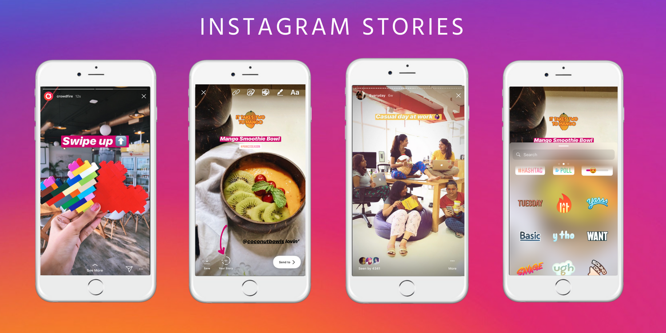
THE FINLAB TOOLKIT

Slide 16
THE HOOK MODEL | STAGE TWO
ACTION
If a user does not take action then any triggers are useless. To initiate action, doing must be easier than thinking. Action is brought about by motivation (the use benefit and how its communicated) and ability (the resources and skills). In order to generate action, simplicity and ease are hugely responsible. We can look at easing action through six lenses.
THE FINLAB TOOLKIT

Slide 17
THE HOOK MODEL | STAGE TWO | ACTION | LENSES 1 & 2
TIME
The amount of time it takes to complete an action.
MONEY
The monetary cost of taking an action.
THE FINLAB TOOLKIT

Slide 18
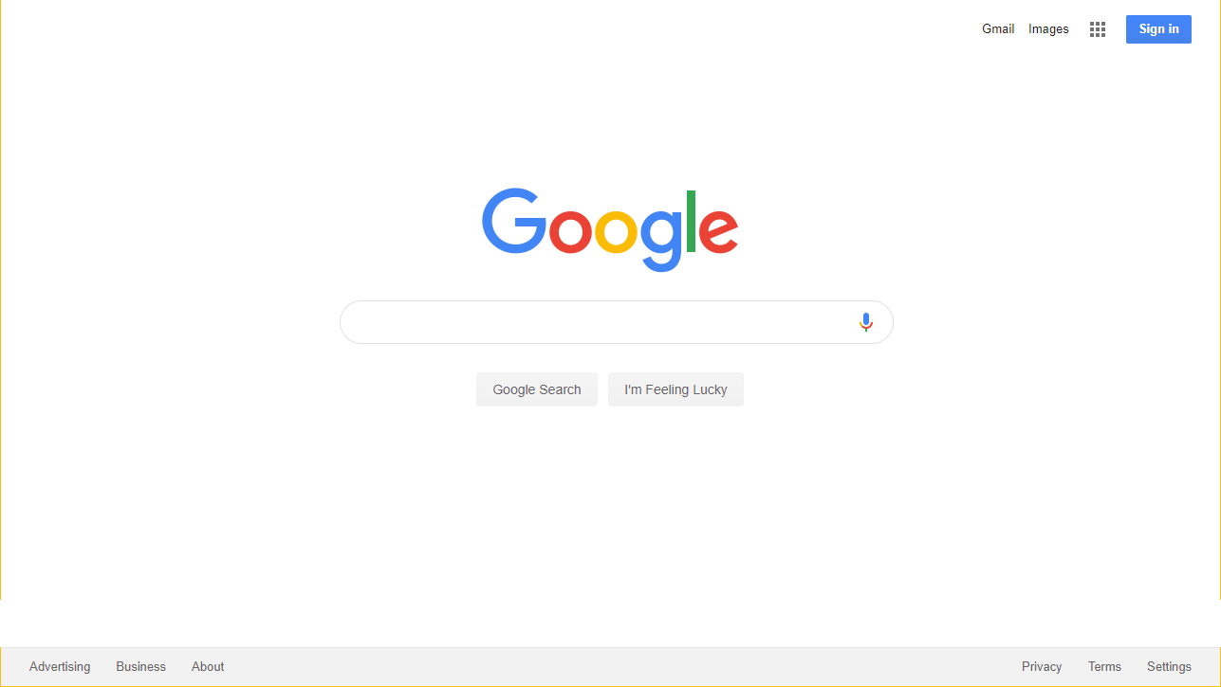
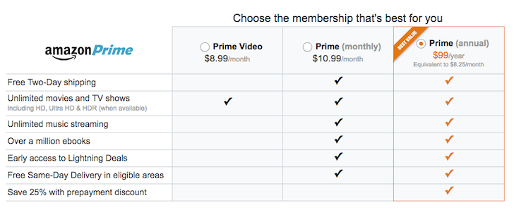
THE FINLAB TOOLKIT

Slide 19
THE HOOK MODEL | STAGE TWO | ACTION | LENSES 3 & 4
PHYSICAL EFFORT
The amount of labour involved in taking an action.
BRAIN CYCLES
The level of mental effort and focus required for action.
THE FINLAB TOOLKIT

Slide 20
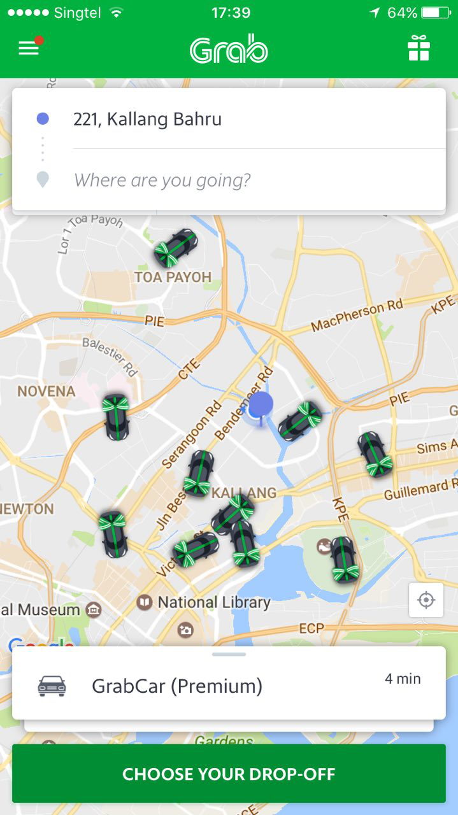
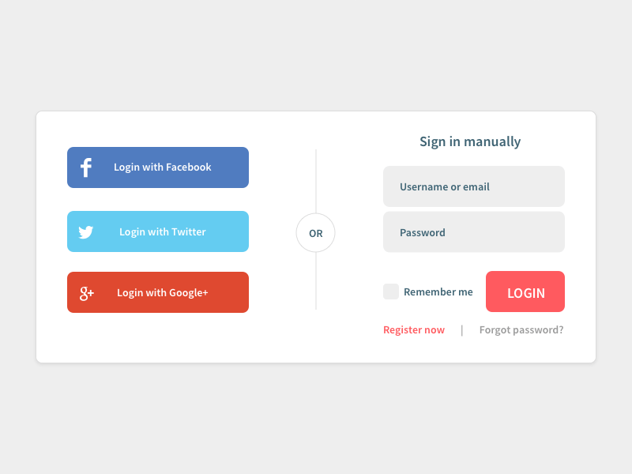
THE FINLAB TOOLKIT

Slide 21
THE HOOK MODEL | STAGE TWO | ACTION | LENSES 5 & 6
SOCIAL DEVIANCE
The level of acceptance an action has from others.
NON ROUTINE
Level to which action matches/disrupts existing routines.
THE FINLAB TOOLKIT

Slide 22

THE FINLAB TOOLKIT

Slide 23
THE HOOK MODEL | STAGE THREE
VARIABLE REWARDS
Beyond the core benefit of a product or service, Rewards and Variable Rewards in particular are reasons that encourage users to keep engaged. Variable rewards are defined as rewards that vary with time and are somewhat unpredictable - helping keep the novelty of the user experience, and creating engagement. There are three broadly kinds of rewards.
THE FINLAB TOOLKIT

Slide 24
THE HOOK MODEL | STAGE THREE | VARIABLE REWARDS | TYPE 1
REWARD OF THE TRIBE
Rewards fuelled by the need to be connected to, accepted, recognised, admired, respected etc. by other people.
THE FINLAB TOOLKIT

Slide 25
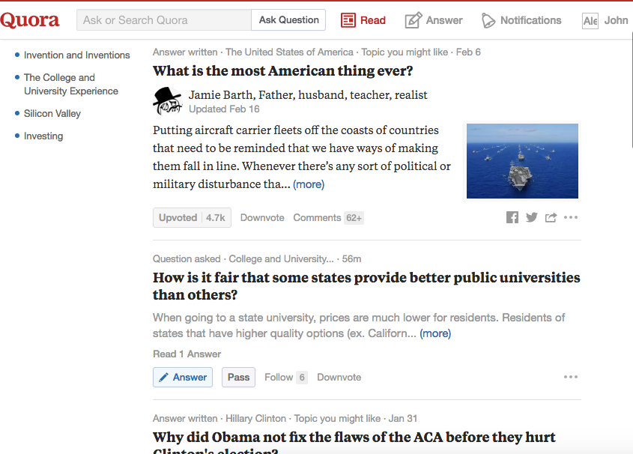
THE FINLAB TOOLKIT

Slide 26
THE HOOK MODEL | STAGE THREE | VARIABLE REWARDS | TYPE 2
REWARD OF THE HUNT
Rewards fuelled by the need to acquire physical products/material resources, and information.
THE FINLAB TOOLKIT

Slide 27
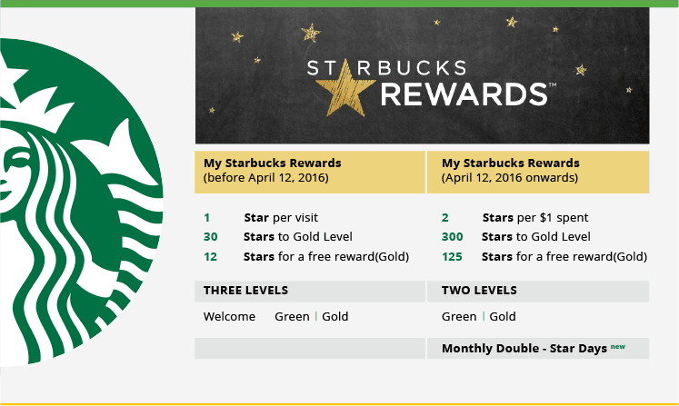
THE FINLAB TOOLKIT

Slide 28
THE HOOK MODEL | STAGE THREE | VARIABLE REWARDS | TYPE 3
REWARD OF THE SELF
Rewards fuelled by ‘intrinsic motivations’ focused on self development and growth such as the need to acquire a sense of mastery, competence, or completion.
THE FINLAB TOOLKIT

Slide 29
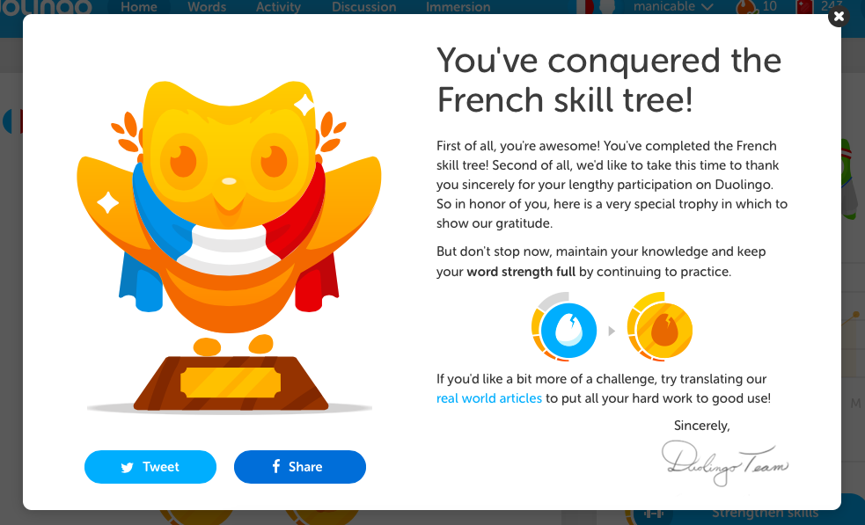
THE FINLAB TOOLKIT

Slide 30
THE HOOK MODEL | STAGE THREE | VARIABLE REWARDS
CONSIDERATIONS FOR REWARDS
Rewards in themselves are not enough to sustain consistent use. There are three big considerations -
Rewards alone do not suffice, a product/service has to address a real user need.
Rewards cannot be used to force people do something they do not essentially want to do.
Products and services with infinite variability (for example, a user generated content site) and thus novelty, have a much better chance of retaining attention than products with finite variability.
THE FINLAB TOOLKIT

Slide 31
THE HOOK MODEL | STAGE FOUR
INVESTMENT
Before users build mental associations with a product or service, they have to be invested into it. The more users invest time and effort into a product or service, the more they value it. This sense of value is created over time because people put a premium on their efforts, they like to be consistent and build on previous behaviour, and they even change their behaviours to avoid cognitive dissonance. There are 5 ways to look at investment.
.
THE FINLAB TOOLKIT

Slide 32
THE HOOK MODEL | STAGE FOUR | INVESTMENT | METHOD ONE
CONTENT
The collection of memories and experiences, in aggregate, becomes more valuable over time and the service becomes harder to leave as users’ personal investment in the site grows.
THE FINLAB TOOLKIT

Slide 33
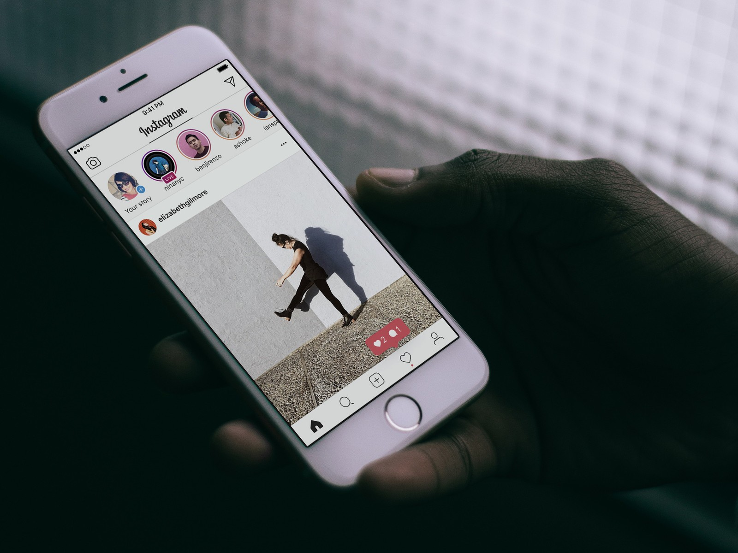
THE FINLAB TOOLKIT

Slide 34
THE HOOK MODEL | STAGE FOUR | INVESTMENT | METHOD TWO
DATA
The more information users share and engage with a product or service, the more committed they become to it.
THE FINLAB TOOLKIT

Slide 35
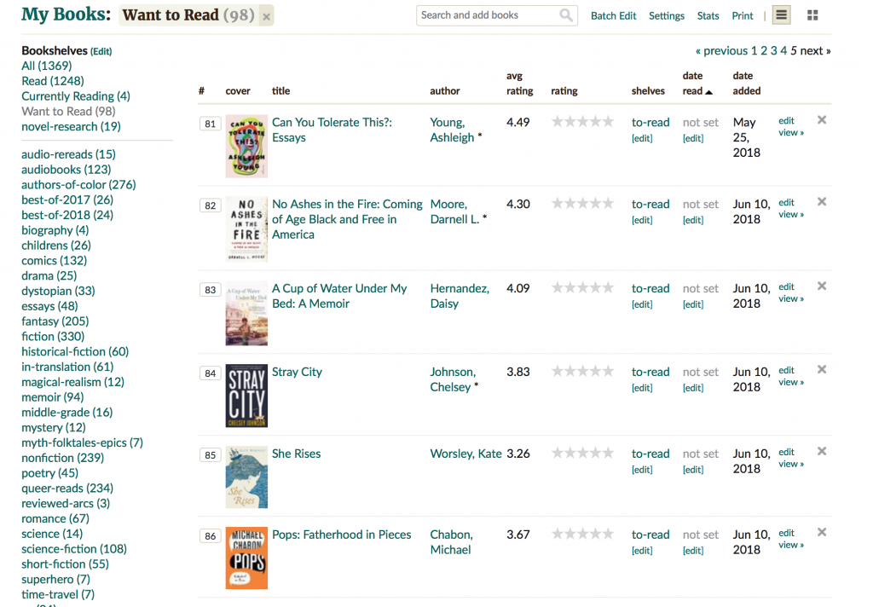
THE FINLAB TOOLKIT

Slide 36
THE HOOK MODEL | STAGE FOUR | INVESTMENT | METHOD THREE
NETWORK
The more invested users’ are in a network of people - as a follower, a friend, as a peer etc. - the less likely they are to abandon a product or service and start over.
THE FINLAB TOOLKIT

Slide 37

THE FINLAB TOOLKIT

Slide 38
THE HOOK MODEL | STAGE FOUR | INVESTMENT | METHOD FOUR
REPUTATION
The reputation that users build or earn over time is what gets them to stay invested over long periods of time.
THE FINLAB TOOLKIT

Slide 39
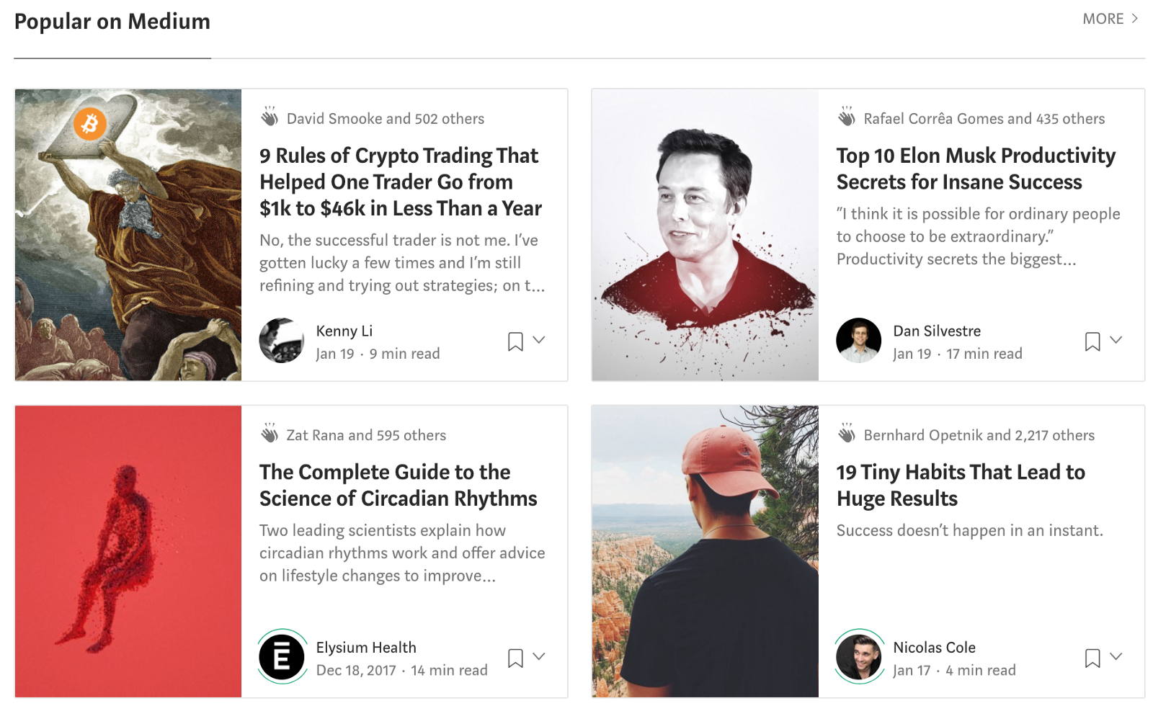
THE FINLAB TOOLKIT

Slide 40
THE HOOK MODEL | STAGE FOUR | INVESTMENT | METHOD FIVE
SKILL
Once users have invested the effort to acquire a skill, they are less likely to switch to a competing product.
THE FINLAB TOOLKIT

Slide 41
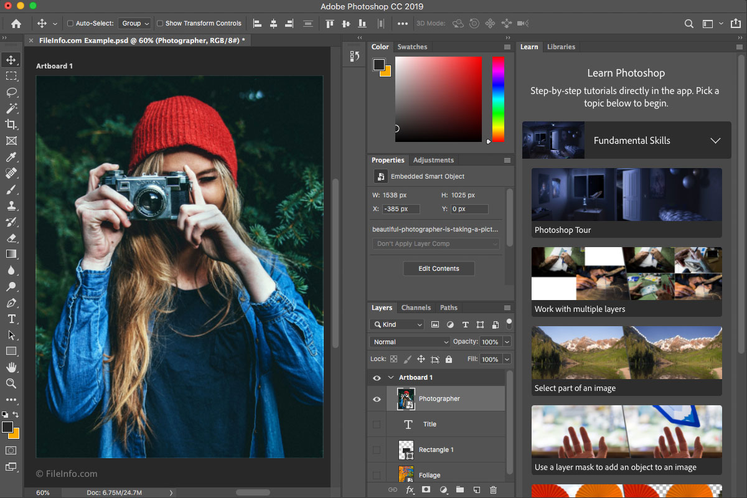
THE FINLAB TOOLKIT

